Slide 1
Introduction to Data Warehouse
Jisha Babu

Slide 2
What Is a Data Warehouse?
“A data warehouse is a subject-oriented, integrated, time-variant, and nonvolatile collection of data in support of management’s decision making process”
Subject oriented:customers,product,sales etc
Integrated: constructed by integrating multiple heterogeneous sources
time-variant: e.g., the past 5–10 years
Nonvolatile:

Slide 3
A Multidimensional Data Model
‘Data cube’
A data cube allows data to be modeled and viewed in multiple dimensions. It is defined by dimensions and facts.
dimensions are entities with respect to which
an organization wants to keep records
Facts are numerical measures.

Slide 4
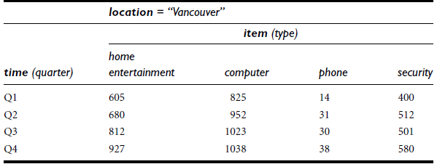
2-D cube

Slide 5
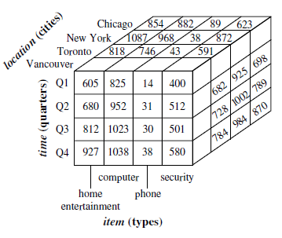

Slide 6
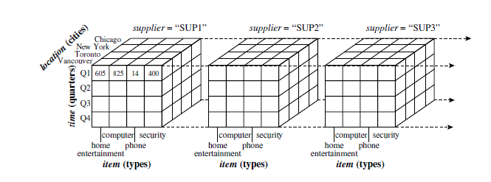

Slide 7
Schemas for Multidimensional Databases
star schema,
snowflake schema
fact constellation schema

Slide 8
Star schema
large central table (fact table) containing the bulk of the data, with no redundancy,
set of smaller attendant tables (dimension tables), one for each dimension.

Slide 9
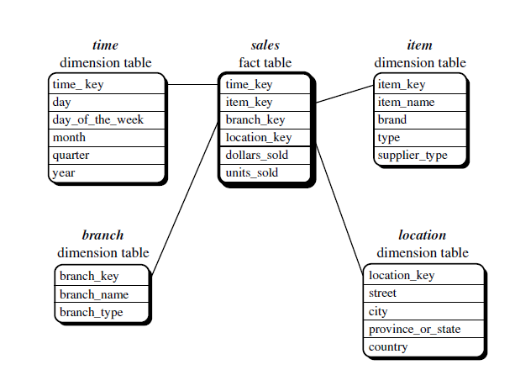

Slide 10
Snowflake schema
some dimension tables are normalized, thereby further splitting the data into additional tables

Slide 11
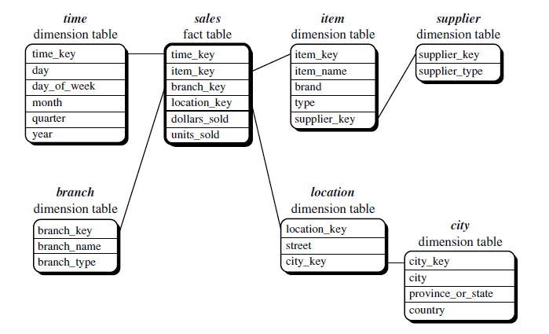

Slide 12
Fact constellation
multiple fact tables to share dimension tables

Slide 13
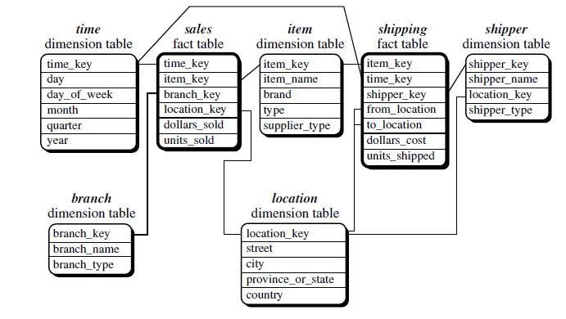

Slide 14
Computation of measures
measure value is computed for a given point by aggregating the data corresponding to the respective dimension-value pairs
Eg. MAX(),COUNT(),MIN(),SUM()

Slide 15
Concept Hierarchies
a sequence of mappings from a set of low-level concepts to higher-level concepts

Slide 16
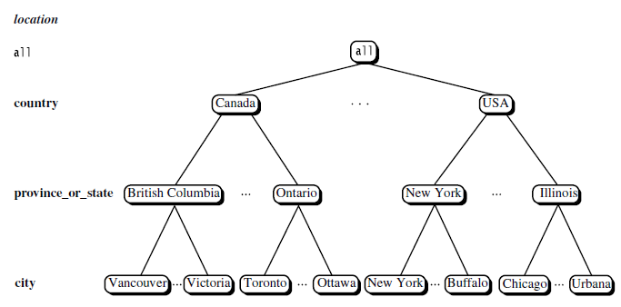

Slide 17
OLAP operations on Concept Hierarchy
The roll-up operation performs aggregation on a data cube, either by climbing up a concept hierarchy for a dimension or by dimension reduction.
Drill-down is the reverse of roll-up. It navigates from less detailed data to more detailed data.

Slide 18
Slice and dice: The slice operation performs a selection on one dimension of the given cube, resulting in a subcube.
The dice operation defines a subcube by performing a selection on two or more dimensions

Slide 19
Pivot : visualization operation that rotates the data axes in view in order to provide an alternative presentation of the data.

Slide 20
DataWarehouse Architecture

Slide 21
Design
Views regarding the design
top-down view: -selection
data source view:- exposes the information
data warehouse view:- fact tables and dimension tables
business query view:- end user

Slide 22
Process of design
top-down approach
bottom-up approach
Design process:
Choose a business process to model
Choose the grain
Choose the dimensions
Choose the measures

Slide 23
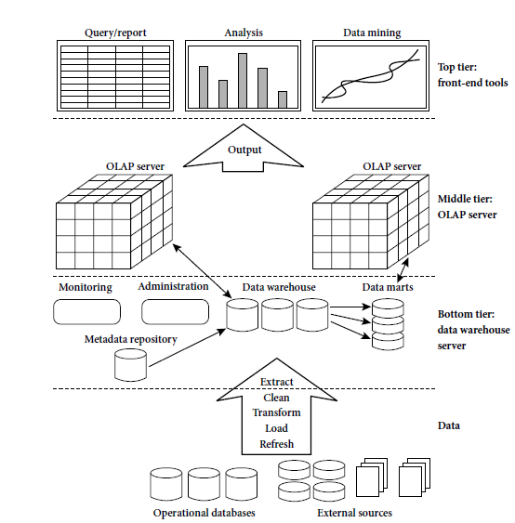
Three-Tier DataWarehouse Architecture

Slide 24
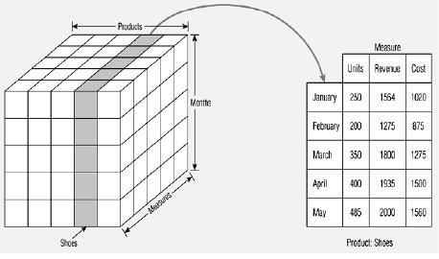

Slide 25
DataWarehouse Back-End Tools and Utilities
Data extraction
Data cleaning
Data transformation
Load
Refresh

Slide 26
Metadata Repository
metadata are the data that define warehouse objects
structure of the data warehouse: schema, view, dimensions
Operational metadata
The algorithms used for summarization

Slide 27
Mining Frequent Patterns

Slide 28
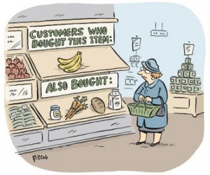
Market Basket Analysis

Slide 29
Items appear frequently together in a transaction data set is a frequent itemset

Slide 30
Support and Confidence
Support s, where s is the percentage of transactions in D that contain AUB (i.e., the union of sets A and B, or say, both A and B). This is taken to be the probability, P(AUB)
The rule AUB has confidence c in the transaction set D, where c is the percentage of transactions in D containing A that also contain B. This is taken to be the conditional probability, P(B/A)
support(A=>B) = P(AUB)
confidence(A=>B) = P(B/A)

Slide 31
A set of items is referred to as an itemset.
The occurrence frequency of an itemset is the number of transactions that contain the itemset.
also known frequency, support count, or count of the itemset.

Slide 32
How are association rules mined from large databases?
Association rule mining is a two-step process:
Find all frequent itemsets → each of these itemsets will occur at least as frequently as a predetermined minimum support count, min sup
Generate strong association rules from the frequent itemsets → these rules must satisfy minimum support and minimum confidence

Slide 33
Scalable Methods for Mining Frequent Patterns
The downward closure property of frequent patterns
Any subset of a frequent itemset must be frequent
If {milk, bread, butter} is frequent, so is {milk, bread}
Scalable mining methods: Three major approaches
Apriori
Freq. pattern growth (FPgrowth)
Vertical data format approach

Slide 34
The apriori algorithm
Apriori property: All nonempty subsets of a frequent itemset must also be frequent
Two step process:
Join
prune

Slide 35
Join step
To find L_{k}
To discover the set of frequent 2-itemsets, L2, the algorithm uses the join L1 on L1 to generate a candidate set of 2-itemsets

Slide 36
Prune step
To find C_{k}
C_{k} is a superset of L_{k}
A scan of the database to determine the count of each candidate in C_{k} would result in the determination of L_{k} (i.e., all candidates having a count not less than the minimum support count are frequent by definition, and therefore belong to L_{k})

Slide 37
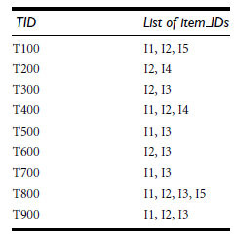
example

Slide 38
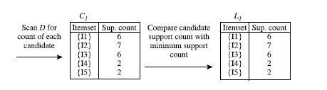
Iteration 1

Slide 39
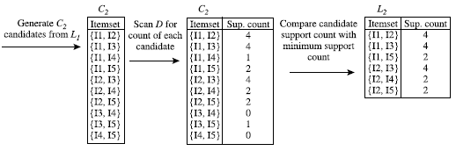
Iteration 2

Slide 40

Iteration 3

Slide 41
Generating association rules
For each frequent itemset l, generate all nonempty subsets of l.
For every nonempty subset s of l, output the rule “s→(l - s)” if
support count(l)/support count(s) >= min conf, where min conf is the minimum confidence threshold

Slide 42
Mining Multilevel Association Rules
Association rules generated from mining data at multiple levels of abstraction are called multiple-level or multilevel association rules
using concept hierarchies under a support-confidence framework.

Slide 43
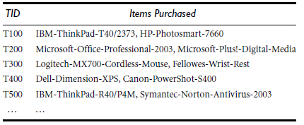

Slide 44
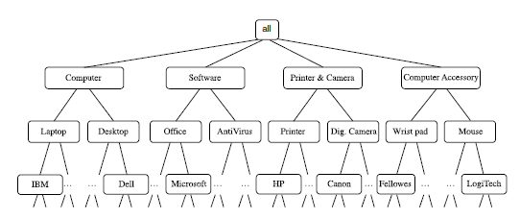

Slide 45
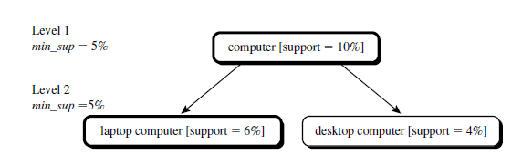

Slide 46
Constraint-Based Association Mining
A good heuristic is to have the users specify such intuition or expectations as constraints to confine the search space
Knowledge type constraints
Data constraints
Dimension/level constraints
Interestingness constraints
Rule constraints

